Slide 1

Business Analytics with R
Fraudulent Credit Card Transaction Detection
Presented by: Arwin Kumar Ravi
Barath Kumar Dhanasekar
Devamsh Varma Mudunuri
Eswar Avinash Nadella
Mahadevan Ramanan
Manoj Krishna Manepalli

Slide 2

Problem Statement
Credit Card transactions in daily life
Risks associated with these transactions
Need to identify fraudulent transactions

Slide 3

Our Analysis and Target Variable
Study and understand different variables that are involved in a credit card transaction
Predict whether a credit card transaction is fraudulent or not
ML algorithms used – decision tree classifier, logistic regression

Slide 4
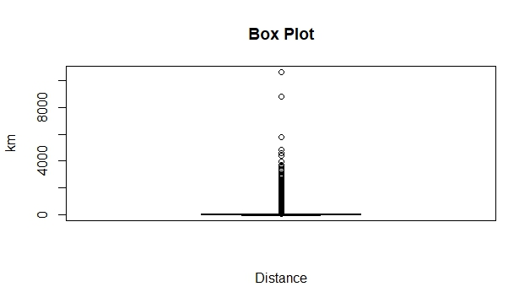
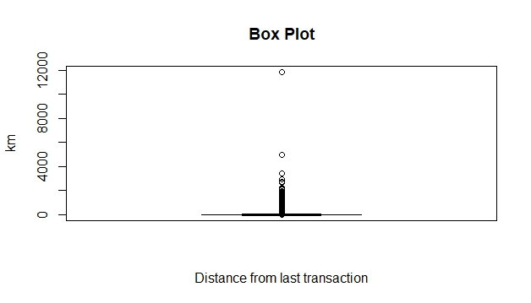
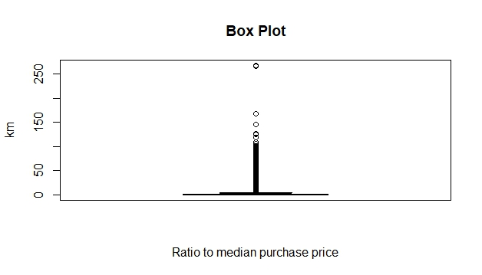
Data Visualization and Exploration
The image shows a boxplot for numerical variables in the dataset
Using IQR, which is a way to study the spread of the data, the upper and lower bounds are calculated by adding and subtracting 1.5 times the IQR from the median.
IQR = Q3 – Q1, where Q1 is the 25th percentile, and Q3 is the 75th percentile
103,631 outliers in the column Distance from home
124,367 outliers in the column Distance from last transaction
84,386 outliers in the column Ratio to median purchase price

Slide 5
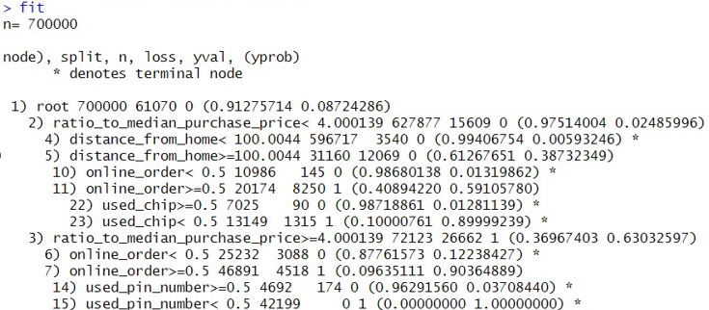
Decision Tree Classifier
We have trained the model based on the following split – 70% train, 30% test
Basic Results

Slide 6
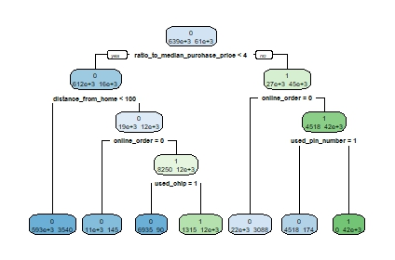
Decision Tree Classifier
Tree Interpretation – Test Dataset
True Positive (TP): Pred Pos & Actual Pos
False Positive (FP): Pred Pos & Actual Neg
True Negative (TN): Pred Neg & Actual Neg
False Negative (FN): Pred Neg & Actual Pos
Summary TP = 24632 FP = 689
TN = 272978
FN = 1701

Slide 7
Decision Tree Classifier
Confusion matrix of train dataset -
Actual | Actual
Predicted | 0 | 1
0 | 637615 | 7037
1 | 1315 | 54033
Performance of the train dataset
Accuracy = 0.992
Error Rate = 0.008
TPR = 0.935
FNR = 0.065
TNR = 0.997
FPR = 0.003
Performance of the test dataset
Accuracy = 0.988
Error Rate = 0.012
TPR = 0.88
FNR = 0.12
TNR = 0.998
FPR = 0.002
Confusion matrix of test dataset -
Actual | Actual
Predicted | 0 | 1
0 | 273122 | 3121
1 | 545 | 23212

Slide 8
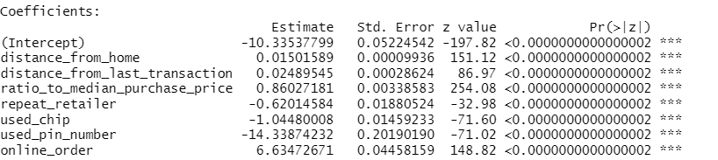
Logistic Regression
We have trained the model based on the following split – 70% train, 30% test
Summary of the logistic regression performed –
Interpretations –
An increase in distance_from_home by a mile, provided all other values are kept constant will increase the odds of credit card transaction being fraudulent by 1.51%
An increase in distance_from_last_transaction by a mile, provided all other values are kept constant will increase the odds of credit card transaction being fraudulent by 2.5%
Provided all other values are constant, If the ratio of the purchase price to the median price increases by a unit, the odds of credit card transaction being fraudulent increases by 136%

Slide 9
Logistic Regression - Performance
Confusion matrix of train dataset -
Actual | Actual
Predicted | 0 | 1
0 | 634573 | 24281
1 | 4357 | 36789
Performance of the train dataset
Accuracy = 0.96
Error Rate = 0.04
TPR = 0.60
FNR = 0.40
TNR = 0.99
FPR = 0.01
Performance of the test dataset
Accuracy = 0.96
Error Rate = 0.04
TPR = 0.59
FNR = 0.41
TNR = 0.99
FPR = 0.01
Confusion matrix of test dataset -
Actual | Actual
Predicted | 0 | 1
0 | 271813 | 10712
1 | 1854 | 15621

Slide 10
Logistic Regression - Performance
Confusion matrix of train dataset -
Actual | Actual
Predicted | 0 | 1
0 | 634573 | 24281
1 | 4357 | 36789
Performance of the train dataset
Accuracy = 0.96
Error Rate = 0.04
TPR = 0.60
FNR = 0.40
TNR = 0.99
FPR = 0.01
Performance of the test dataset
Accuracy = 0.96
Error Rate = 0.04
TPR = 0.59
FNR = 0.41
TNR = 0.99
FPR = 0.01
Confusion matrix of test dataset -
Actual | Actual
Predicted | 0 | 1
0 | 271813 | 10712
1 | 1854 | 15621

